Slide 1
Открытый урок по дисциплине «ОД.04 Иностранный язык»
Специальность 54.01.20 «Графический дизайнер»
(первый год обучения)
Кузнецова Н.А., преподаватель английского языка, первая квалификационная категория
2023

Slide 2
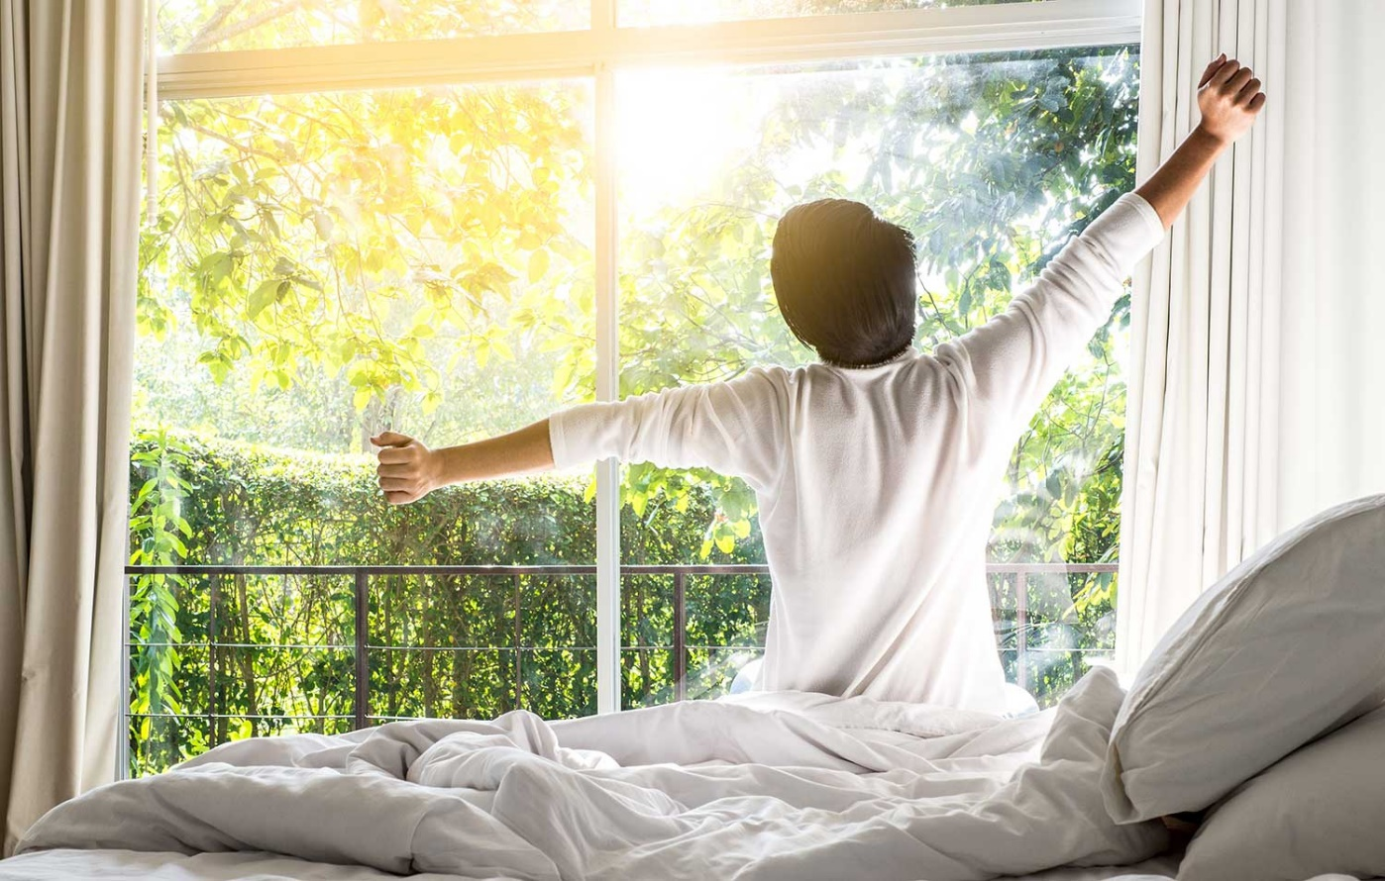
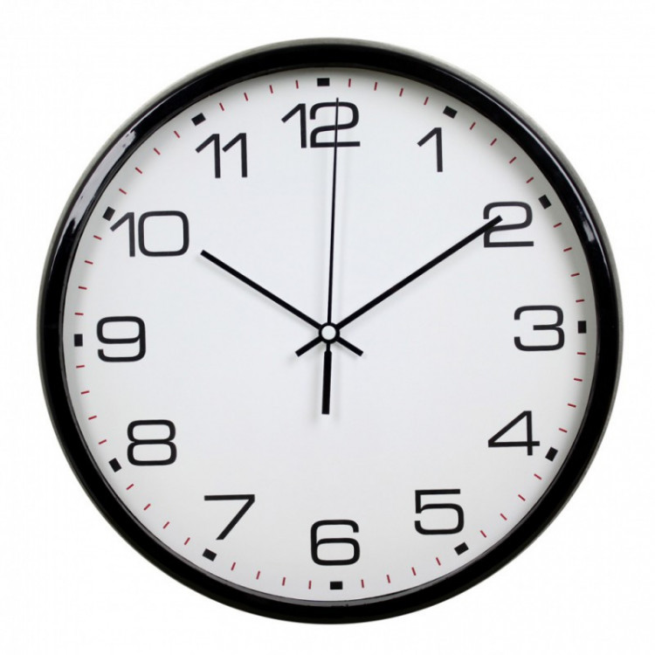
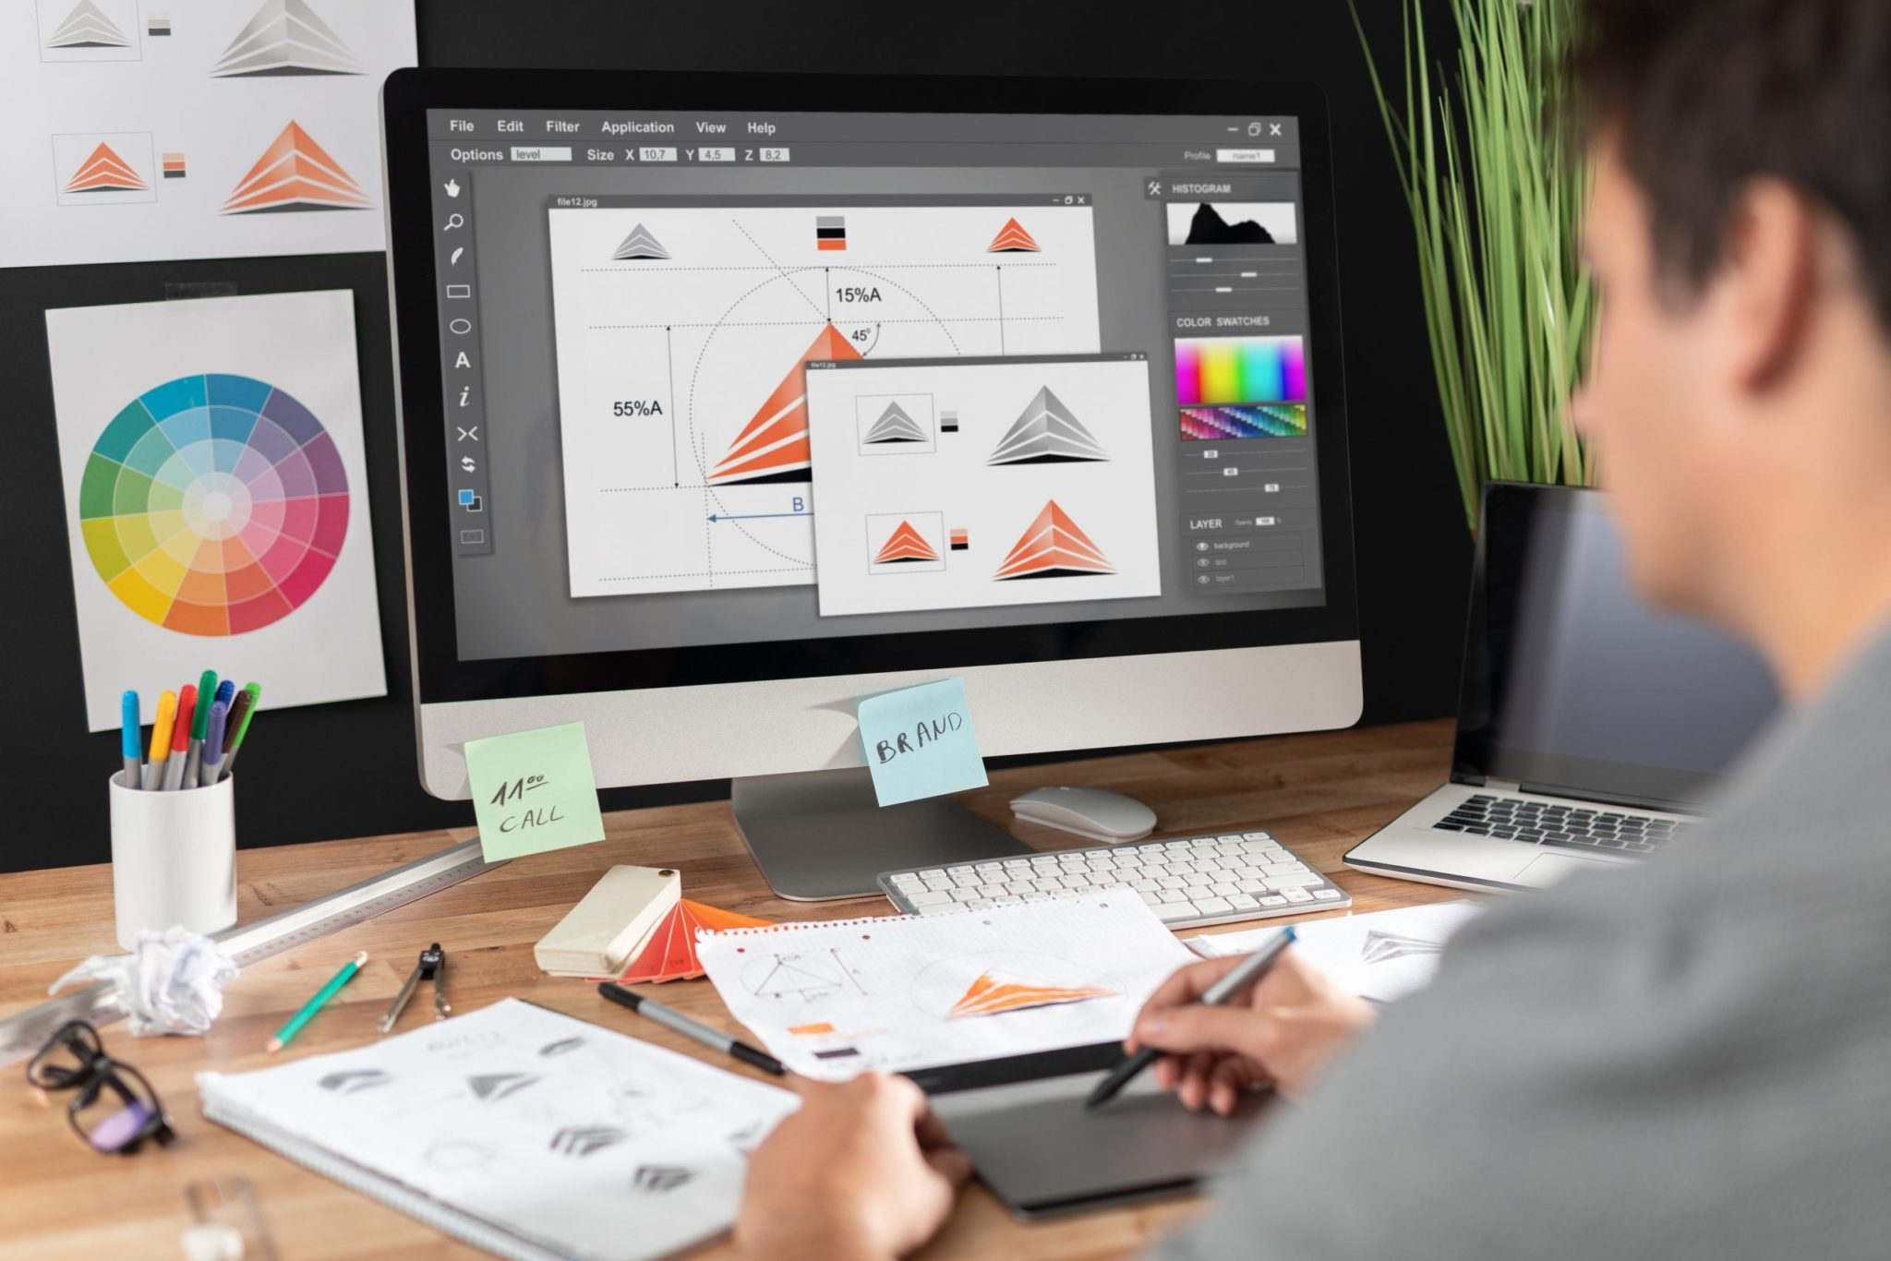
What do you see in these photos? What are these people doing?
When do we usually do it: on weekdays or at weekends?

Slide 3
Present Indefinite Tense
I work on my design projects on weekdays.
She works on her design projects on weekdays.
I don’t work on my design projects at weekends.
She doesn’t work on her design projects at weekends.
- Do you work on your design projects at weekends? – Yes, I do. / No, I don’t.
- Does she work on her design projects at weekends? – Yes, she does. / No, she doesn’t.

Slide 4
Adverbs of frequency
always, often, usually, sometimes, rarely, never
She usually meets with clients on Tuesdays and Thursdays.
He is never late for meetings with clients.
She doesn’t often have meetings with clients
in the evenings.

Slide 5
Prepositions of time
On
In
At
- days of week: on Monday
- on weekdays
- on Monday morning
- in the morning
- in the afternoon
- in the evening
- time: at 9 o’clock
- at the weekend
- at night, at noon

Slide 6
Grammar exercise
Find the mistakes in the following sentences and correct them:
1. He checks his emails on about 11 a.m.
2. We usually meets with our clients online.
3. How often does you have tight deadlines?
4. At Tuesdays I work on my blog content.
5. They doesn’t like the idea of this design project.
6. Mike doesn’t like face-to-face meetings with clients, that is why he often does it.

Slide 7
Read the text and find word expressions describing a working day of a graphic designer:
A working day of a freelance graphic designer
Hello! My name is Alaina O'Neal and I’m a freelance graphic designer. Here’s a look at my work day, a day in the life of a graphic designer.
From Monday to Friday, I wake up at 9:30 am. I spend about 20 minutes getting ready and then make some coffee and have breakfast. After that it’s time to start the day.
At 10 o’clock I switch on my laptop, check my emails and social media for messages from clients. Sometimes I begin the day and know exactly what I need to work on. But sometimes, I need to decide which project has priority.
I usually start my work with doing edits of actual projects, because they are faster than starting a whole new design project. My projects include creating visually pleased logos, posters, flyers, billboards, product packaging, business cards and other marketing materials. Before doing a computer layout I have to draw sketches by hand.
At about 2 pm I work on my blog content while having lunch. Further, I make some calls to my clients for making appointments or discussing project details. I seldom meet with clients face-to-face, most of them prefer online meetings.
After lunch I sometimes monitor different websites for new clients and orders.
I try to wrap up all my work day by about 7 pm and spend evening with my family, of course, if I’m not on a tight deadline. If I’m feeling inspired, I might work on a side project when my whole family is already asleep. I’ve always been a night owl. And being a freelance graphic designer gives me the flexibility to choose my own schedule.

Slide 8
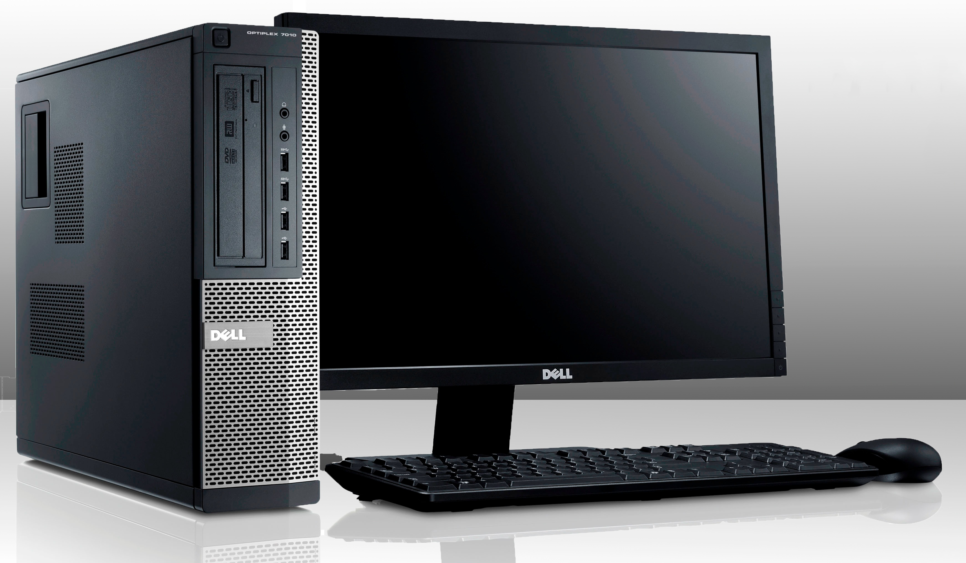
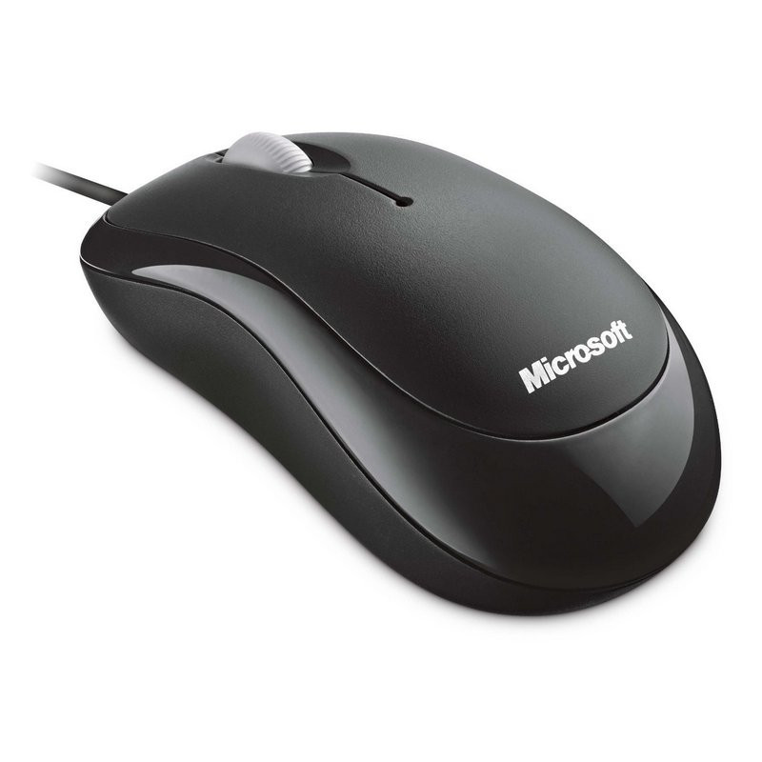
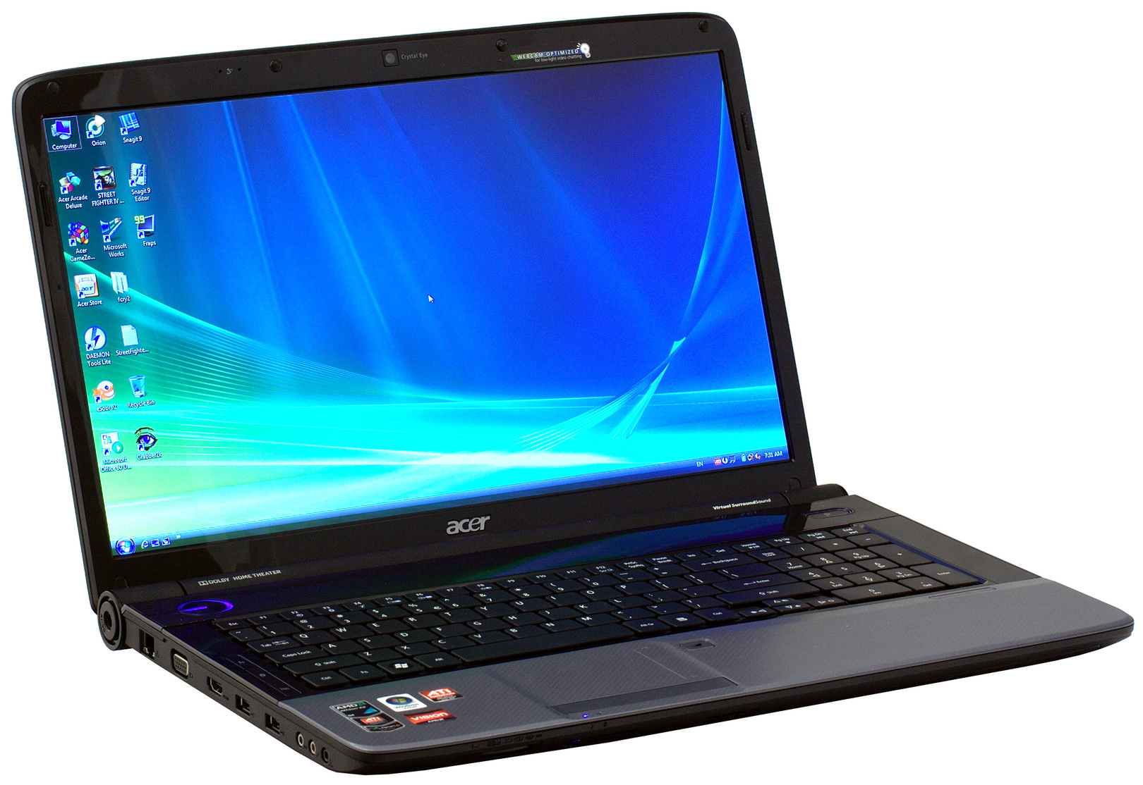
Listen to the advice column and then name SIX types of electronic equipment
that graphic designers use in everyday work:

Slide 9
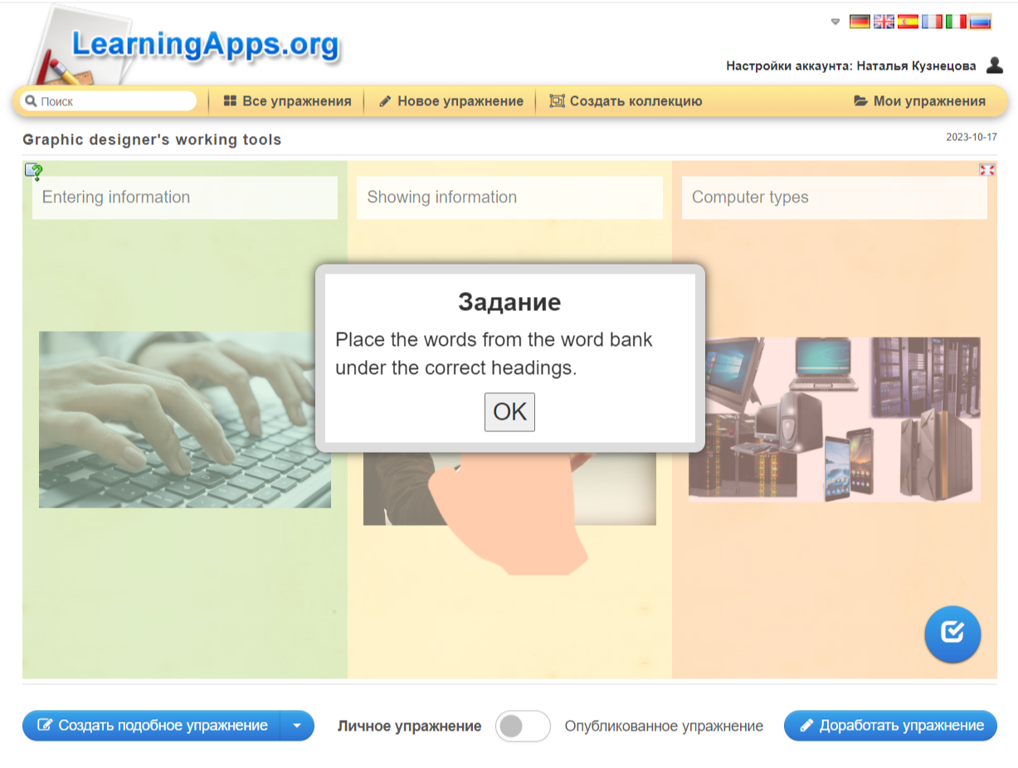
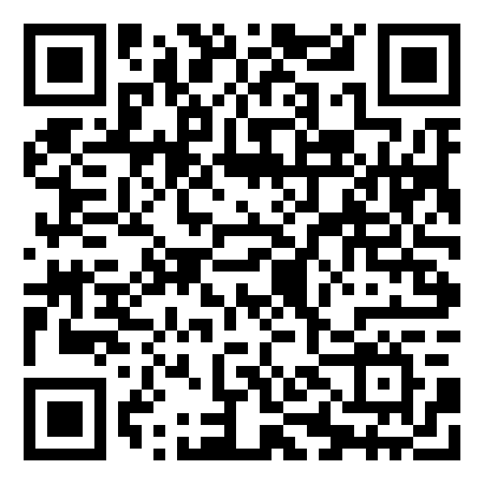

Slide 10
Speech Clichés
At first
Firstly
Then
After that
In short
Skip the details
At the beginning
To be honest
By the way
At last
In the end
Finally

